Slide 1
REQUIREMENTS ENGINEERING
Notes:
Good morning/afternoon ladies and gentlemen. Welcome to Requirements Engineering class of summer 2026! Who’s excited?

Slide 2
LEARNING OBJECTIVES:
Understand and explain the key concepts of Requirements Engineering
Identify and engage with stakeholders effectively
Analyze, prioritize, and model requirements
Write clear and well-structured requirements specifications
Validate and manage requirements
Apply agile approaches to Requirements Engineering
Address and resolve common challenges

Slide 3
Chapter I Introduction to Requirement Engineering

Slide 4
Opinion Poll
How many of you think requirements are an essential part of software engineering / development?
Notes:
The mythical man month is a book that shows how adding more people to a software project only delays the project further. New people require training which is time from existing devs that they could use on the project.

Slide 5
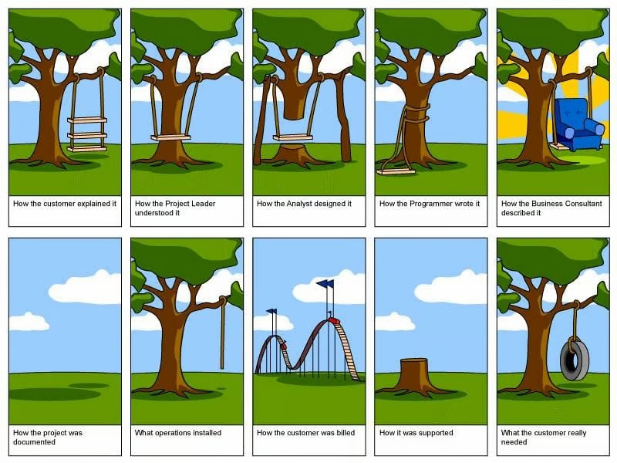
Notes:
The mythical man month is a book that shows how adding more people to a software project only delays the project further. New people require training which is time from existing devs that they could use on the project.

Slide 6
Some Quotes…
The hardest single part of building a software system is deciding precisely what to build. Fred Brooks (from The Mythical Man-Month) ~
A software system is only as good as the communication of the requirements that define it. Karl Wiegers
Notes:
The mythical man month is a book that shows how adding more people to a software project only delays the project further. New people require training which is time from existing devs that they could use on the project.

Slide 7
Chapter 1 Outline
Definition of Requirements Engineering
Importance of Requirements Engineering
Types of Requirements
Stakeholders in Requirement Engineering
Challenges in Requirements Engineering

Slide 8
What is a Requirement?
A requirement is a capability or a condition that must be met in order for a software to solve a problem.
Requirements offer a description of how the system ought to behave once completed.
Requirements reflect the needs of stakeholders.
Requirements are the bridge between business objectives and software implementation.

Slide 9
Definition of Requirements Engineering
Requirements Engineering (RE) is a systematic process of defining, documenting, and maintaining the requirements for a system or software.
It involves understanding the needs of stakeholders and ensuring that the system or product will meet these needs.
The main objective of RE is to ensure the success of a project by clearly identifying the expectations from the system

Slide 10
Importance of Requirements Engineering
Foundation for System Development: It provides a clear understanding of what is to be built, serving as a blueprint for design, implementation, and testing.
Reduction in Project Failure: Poor requirements or misunderstandings can lead to project delays, cost overruns, and product failures. RE helps avoid this by ensuring clarity and agreement from the beginning.

Slide 11
Importance of Requirements Engineering
Stakeholder Alignment: It ensures that the project addresses the needs and expectations of all stakeholders, minimizing the risk of developing a product that does not satisfy its intended users.
Cost Efficiency: Errors in requirements discovered during development or after product delivery are much more expensive to fix. Proper RE minimizes the chance of such errors.

Slide 12
Types of Requirements
Functional Requirements: These define the specific behaviors or functions of the system. For example, a functional requirement for an e-commerce website might be "the system must allow users to create accounts and make purchases online."

Slide 13
Types of Requirements
Non-Functional Requirements: These describe the quality attributes of the system, such as performance, security, usability, and scalability. For example, "the system must support 100,000 concurrent users without crashing" is a non-functional requirement
Domain Requirements: These are requirements that pertain to a particular industry or field within which the system is to be used.

Slide 14
Stakeholders in Requirement Engineering
Stakeholders are individuals or groups with an interest in the development of the system. They can influence the requirements and thus the system's success. Key stakeholders in RE include:
In the 1700s a "stake-holder" was literally the neutral third party who physically held the wagered money in a betting pool until the winner was determined.
Notes:
Talk about the fact that stake-holders is a composite word.

Slide 15
Stakeholders in Requirement Engineering
End Users: People who will directly interact with the system.
Customers/Clients: Those who pay for the system or own the product.
System Engineers/Developers: Responsible for implementing the system based on the requirements.
Project Managers: Oversee the project to ensure timelines and budgets are met.
Regulators: May impose legal or safety requirements.

Slide 16
Challenges in Requirements Engineering
Ambiguity: Misunderstanding or incomplete requirements can lead to confusion during development.
Stakeholder Conflicts: Different stakeholders may have conflicting priorities, making it difficult to align on a set of requirements.

Slide 17
Challenges in Requirements Engineering
Evolving Requirements: In dynamic environments, requirements may change, necessitating flexibility in the RE process.
Communication Gaps: Miscommunication between technical and non-technical stakeholders can result in improper requirement gathering.

Slide 18
Recap
Definition of Requirements Engineering
Importance of Requirements Engineering
Types of Requirements
Stakeholders
Challenges faced in Requirements Engineering

Slide 19
Opinion Poll
How many of you think requirements are an essential part of software engineering / development?
Notes:
The mythical man month is a book that shows how adding more people to a software project only delays the project further. New people require training which is time from existing devs that they could use on the project.

Slide 20
References
H. Possel, “How IT-Projects really work,” Copyright 2003-2005 Heiko Possel. https://www.smart-words.org/jokes/how-it-projects-really-work.html
“Software Requirements Specifications,” IEEE Computer Society, Apr. 17, 2024. https://www.computer.org/resources/software-requirements-specifications#requirements-fundamentals

